Slide 1
Lecture 19 Performance Optimization
Xuan ‘Silvia’ Zhang
Washington University in St. Louis
http://classes.engineering.wustl.edu/ese461/

Slide 2
Project FAQ
Correction
typo in optical flow: I_{y}(i, j) = I₁(i, j+1) – I₁(i, j-1)
I₁(i, j+1) might not exist
Mid-project report
behavioral Verilog code and testbench
show proof of working functional simulation
ensure synthesizable codes
Use of external memory
instantiate in the test bench
used for large data array or buffers

Slide 3
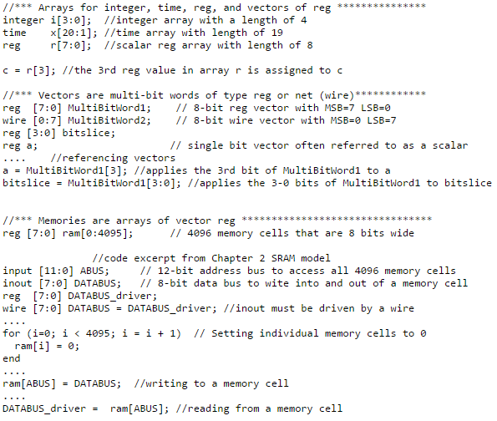
Arrays, Vectors, and Memories

Slide 4
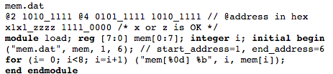
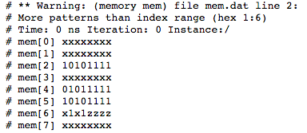
Useful Verilog Features
Display tasks
$display, $displayb (h, o) in binary, hex, and octal
$write, $strobe, $monitor
File I/O tasks
$fopen, $fclose
$fdisplay, $fwrite, $fstrobe, $fmonitor
$readmemb, $readmemh: read a text file into memory

Slide 5
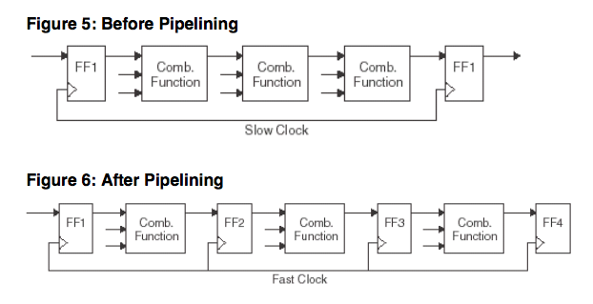
Module Partitioning
Where possible, register module outputs and keep critical path in one block
Design Registering
pipelining
restructure a long data path with several levels of logic and break it up over multiple cycles

Slide 6
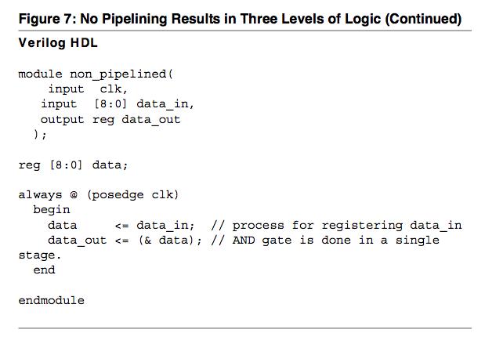
Pipelining

Slide 7
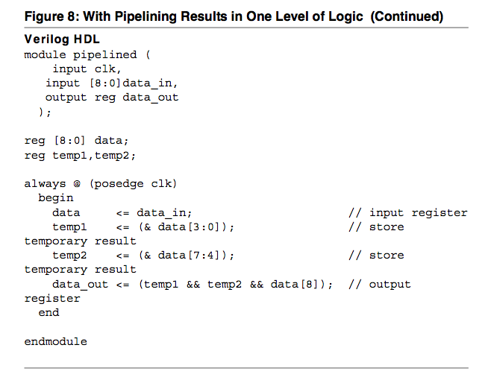
Pipelining

Slide 8

Adding Structure
Control the structure by using separate assignment and parentheses
Example
32-bit arithmetic shift right
design 1
design 2

Slide 9
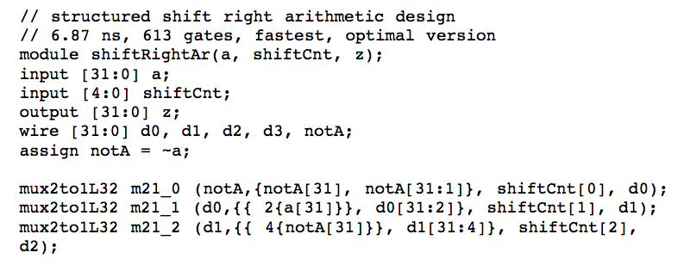
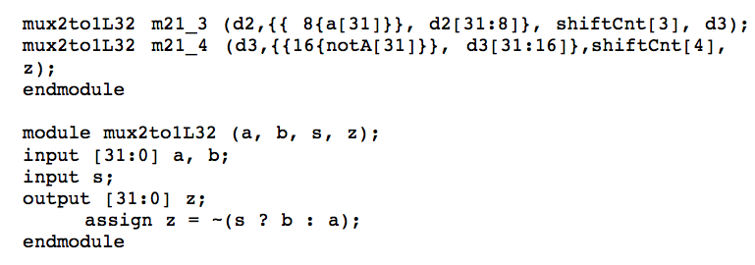
32-Bit Arithmetic Shift Right
Design 3

Slide 10
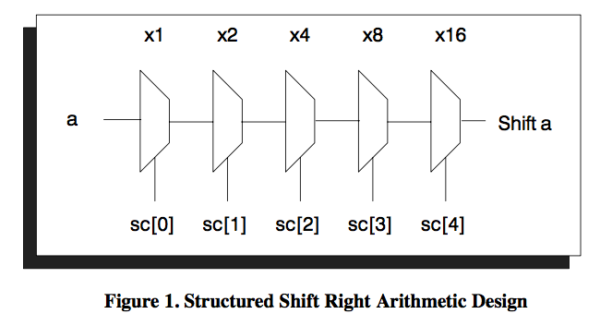
32-Bit Arithmetic Shift Right
Optimal structured design

Slide 11
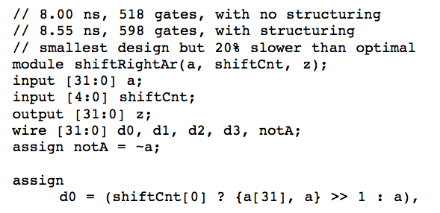
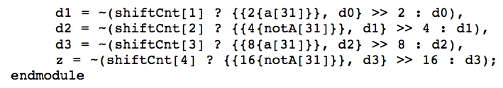
32-Bit Arithmetic Shift Right
Without specifying the mux instantiations

Slide 12
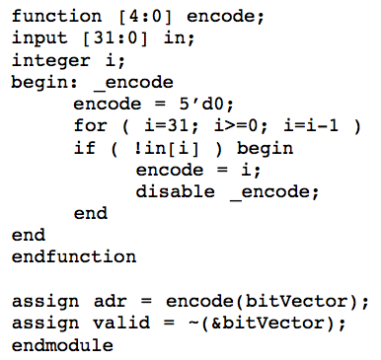
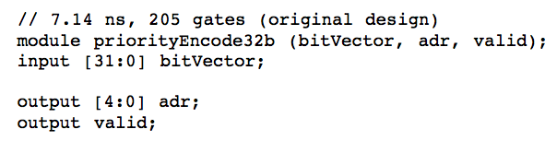
Horizontal Partitioning
Break circuit into horizontal slices to minimize maximum fan-in
Example
carry lookahead adder:
32-bit adder broken to eight 4-bit blocks
32-bit priority encoder

Slide 13
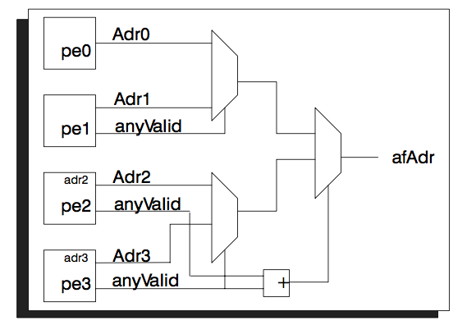
32-Bit Priority Encoder
Restructured with four 8-bit blocks

Slide 14
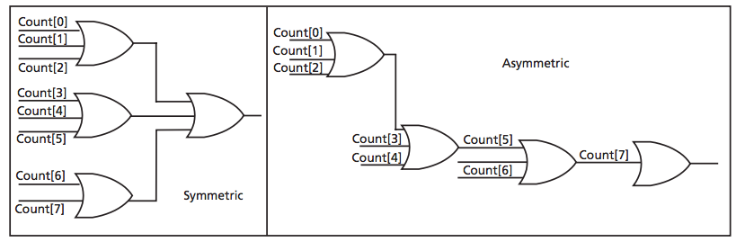
Priority-Encoded Logic vs Balanced Logic
If-Then-Else vs Case Statement
redundant priority

Slide 15
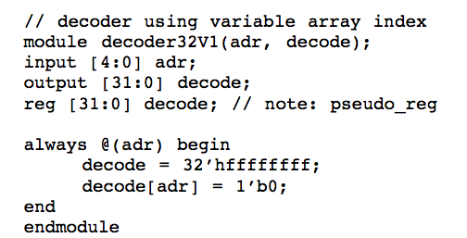
Hierarchy
Collapse hierarchy (flattening)
more efficient synthesis
Add Hierarchy
benefit results from structure preservation
example: 32-bit decoder
least-efficient implementation

Slide 16
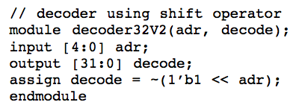
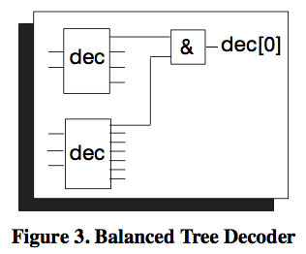
32-Bit Decoder
More concise representation
A balanced tree decoder is even better

Slide 17
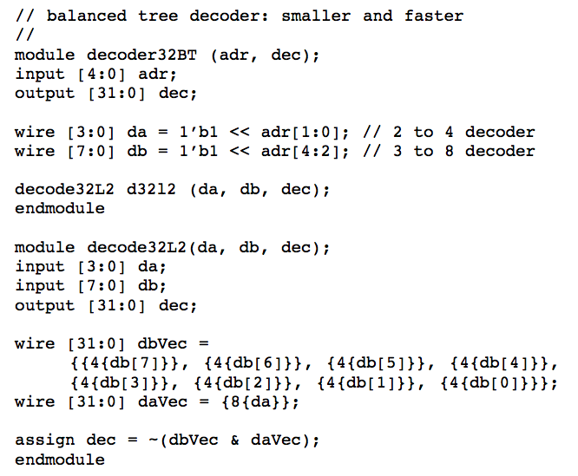
32-Bit Balanced-Tree Decoder

Slide 18
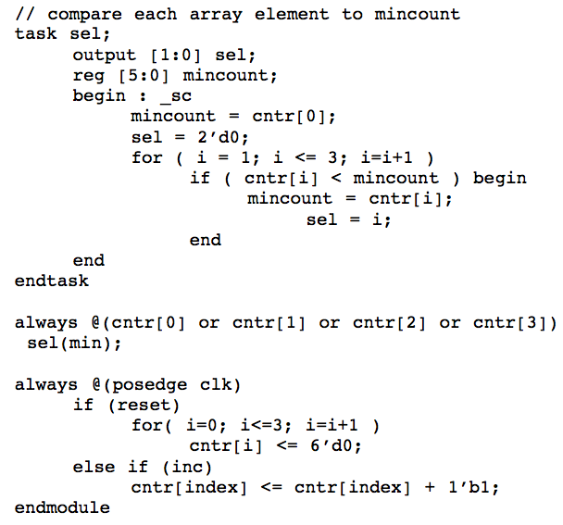
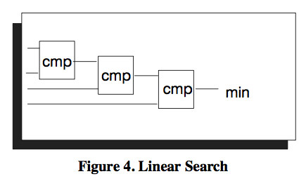

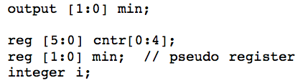
Performing Operations in Parallel
Example
linear search

Slide 19
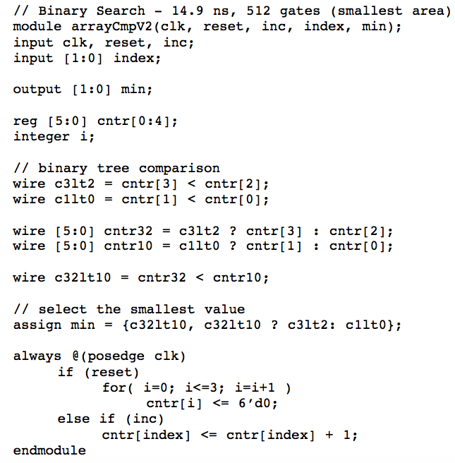
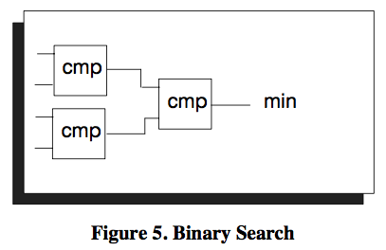
Performing Operations in Parallel
Example
binary search

Slide 20
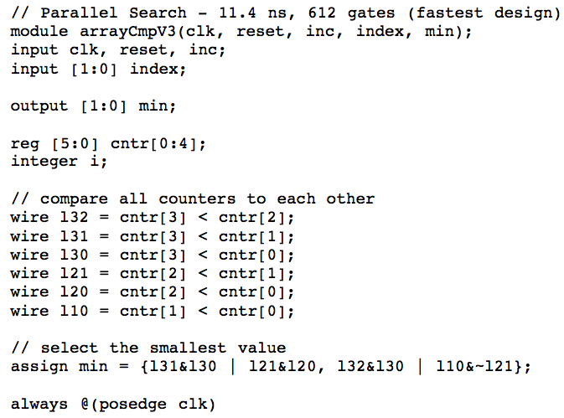
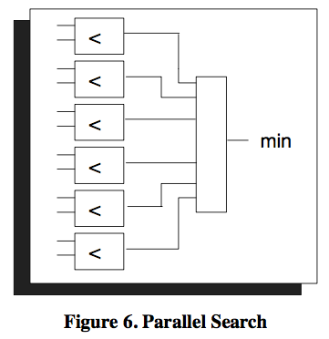
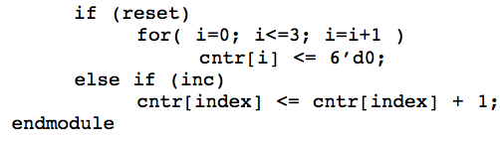
Performing Operations in Parallel
Example
parallel search

Slide 21
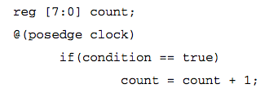
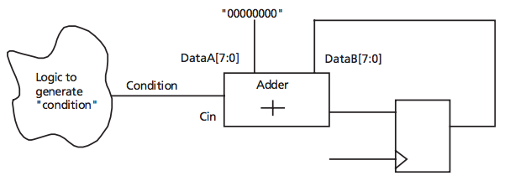
MUX for Conditional Assignment
Example: counter

Slide 22
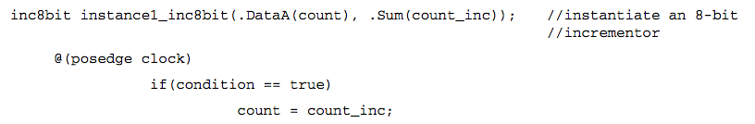
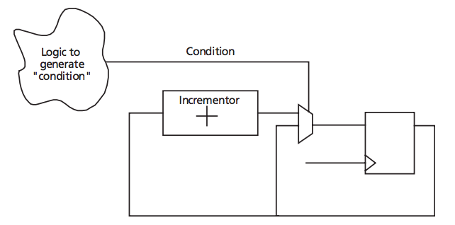
MUX for Conditional Assignment
Example: counter

Slide 23
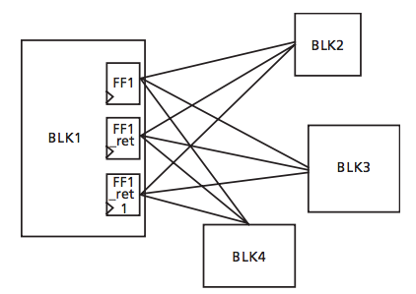
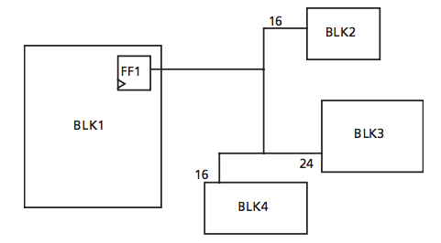
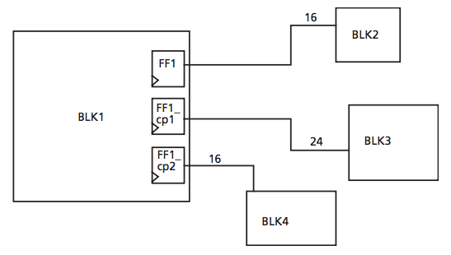
Replication
Large fanout
manual register duplication to reduce congestion

Slide 24
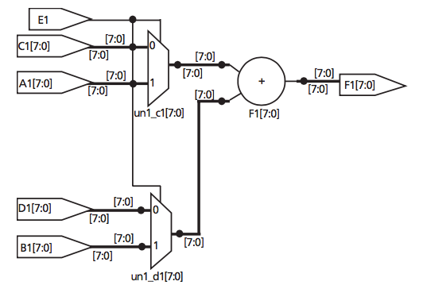
Resource Sharing
Optimize area but hurt speed
with resource sharing

Slide 25
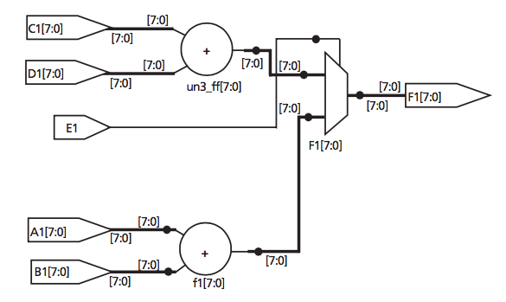
Resource Sharing
Optimize area but hurt speed
without resource sharing

Slide 26
Questions?
Comments?
Discussion?

